Slide 1

Operations Trees Instructor: Md Nazmul Hossain
PRESENTED BY:
Abdullah al Maruf 22-47997-2
S.M.rasel 22-48039-2

Slide 2
What to expect from this presentation?
implement Binary Search Tree operations
Insertion of trees operations
Trees traversal
To search an element on the BST.

Slide 3
What id Binary Search Tree(BST) ?
Binary search tree is a data structure that quickly allows us to maintain a sorted list of numbers
It is called a binary tree because each tree node has a maximum of two children.
It is called a search tree because it can be used to search for the presence of a number in O(log(n)) time.

Slide 4
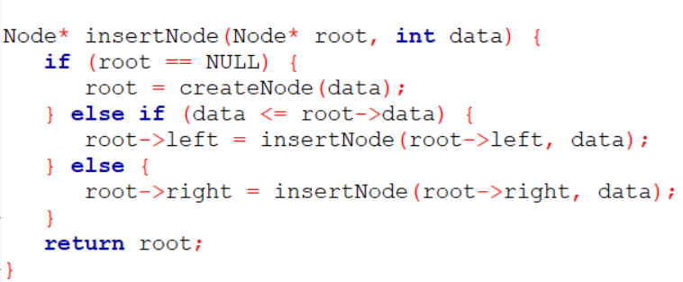

To construct a binary search tree of integers (insert one by one)
Create node

Slide 5
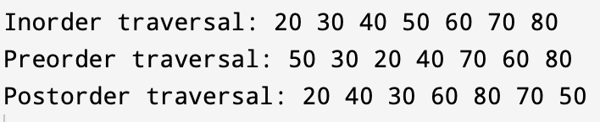
To traverse the tree using all the methods
void inorderTraversal(Node* root) {
if (root == NULL) {
return;
}
inorderTraversal(root->left);
cout << root->data << " ";
inorderTraversal(root->right);
}
void preorderTraversal(Node* root) {
if (root == NULL) {
return;
}
cout << root->data << " ";
preorderTraversal(root->left);
preorderTraversal(root->right);
}

Slide 7
Add a Slide Title - 1

Slide 8
Add a Slide Title - 2

Slide 9
Add a Slide Title - 3

Slide 11
Add a Slide Title - 4

Slide 12
Add a Slide Title - 5

Slide 13
Add a Slide Title - 6

